Slide 1
Object-Oriented Systems
Analysis and Design Using UML
(Activity Diagram)
Systems Analysis and Design Lab
Course Code: CSE 306
Fall 2021 Semester
Instructor:
Ali Zafar Sadiq
Lecturer. CSE Dept., UAP

Slide 2
Activity Diagrams
The dynamic aspect of a system specifies how the system operates to attain its function, complementing its static aspect. The static aspects represent those parts of a diagram, which forms the main structure
Activity diagram is another important diagram in UML to describe the dynamic aspects of the system.
Activity diagram is basically a flowchart to represent the flow from one activity to another activity. The activity can be described as an operation of the system.
The control flow is drawn from one operation to another. This flow can be sequential/concurrent or branched. Activity diagrams deal with all type of flow control by using different elements such as fork, join, etc.

Slide 3
The purpose of an activity diagram
Draw the activity flow of a system.
Describe the sequence from one activity to another.
Describe the parallel/concurrent flow and branched flow of the system.
18-<number>

Slide 4
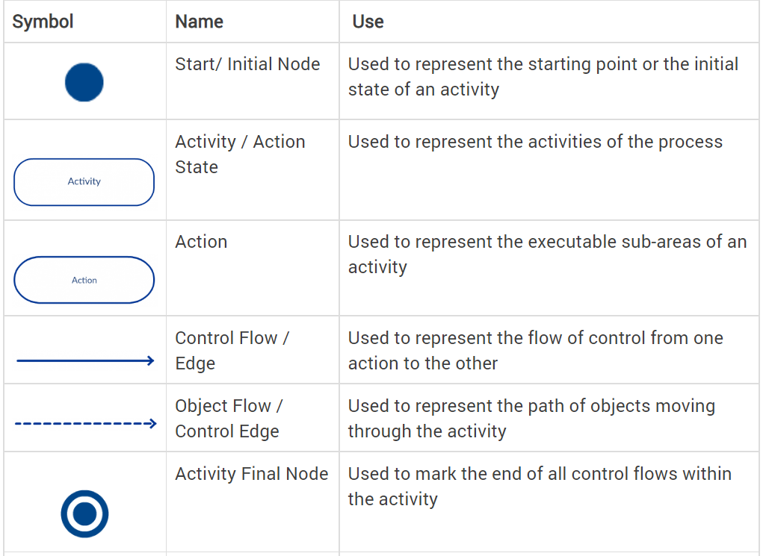
Activity Diagram Symbols
UML has specified a set of symbols and rules for drawing activity diagrams.
18-<number>

Slide 5
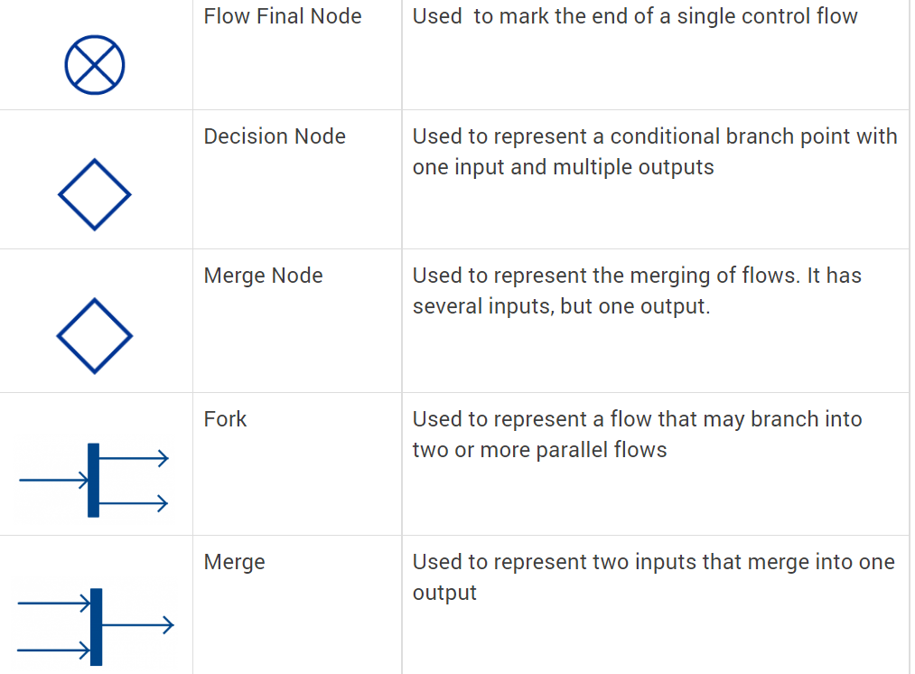
Activity Diagram Symbols
18-<number>

Slide 6
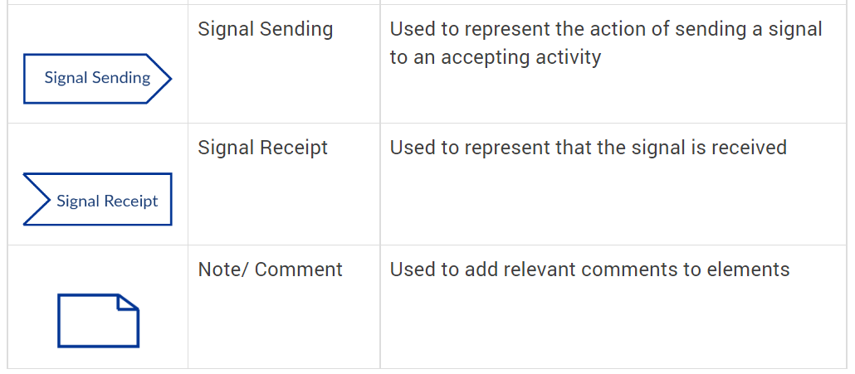
Activity Diagram Symbols
18-<number>

Slide 7
How to Draw an Activity Diagram?
Activity diagrams can be used to model business requirements, create a high-level view of a system’s functionalities, analyze use cases and for various other purposes.
Step 1: Figure out the action steps from the use case: Here you need to identify the various activities and actions your business process or system is made up of.
Step 2: Identify the actors who are involved: If you already have figured out who the actors are, then it’s easier to discern each action they are responsible for.
Step 3: Find a flow among the activities: Figure out in which order the actions are processed. Mark down the conditions that have to be met in order to carry out certain processes, which actions occur at the same time and whether you need to add any branches in the diagram. And do you have to complete some actions before you can proceed to others?
Step 4: Add swimlanes: You have already figured out who is responsible for each action. Now it’s time to assign them a swimlane and group each action they are responsible for under them.
18-<number>

Slide 8
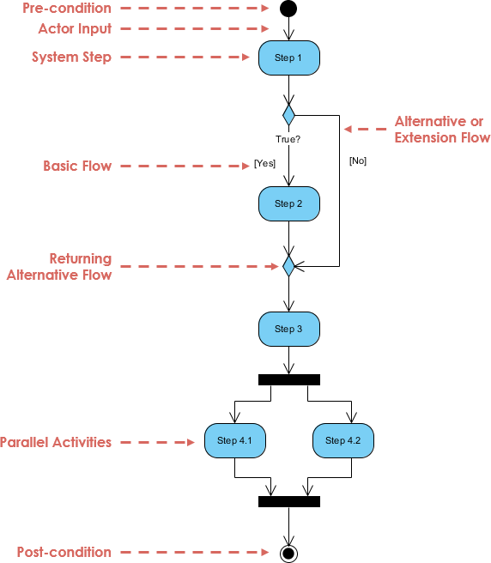
A basic activity diagram - flowchart like
18-<number>

Slide 9
Activity Diagram - Modeling a Word Processor
The activity diagram example below describes the workflow for a word process to create a document through the following steps:
Open the word processing package.
Create a file.
Save the file under a unique name within its directory.
Type the document.
If graphics are necessary, open the graphics package, create the graphics, and paste the graphics into the document.
If a spreadsheet is necessary, open the spreadsheet package, create the spreadsheet, and paste the spreadsheet into the document.
Save the file.
Print a hard copy of the document.
Exit the word processing package
18-<number>

Slide 10
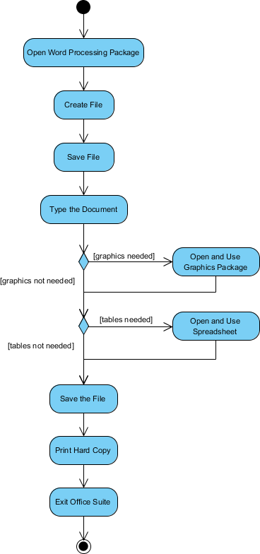
Activity Diagram - Modeling a Word Processor
..
18-<number>

Slide 11
Activity Diagram Example - Student Enrollment
This UML activity diagram example describes a process for student enrollment in a university as follows:
An applicant wants to enroll in the university.
The applicant hands a filled out copy of Enrollment Form.
The registrar inspects the forms.
The registrar determines that the forms have been filled out properly.
The registrar informs student to attend in university overview presentation.
The registrar helps the student to enroll in seminars
The registrar asks the student to pay for the initial tuition.
.
18-<number>

Slide 12
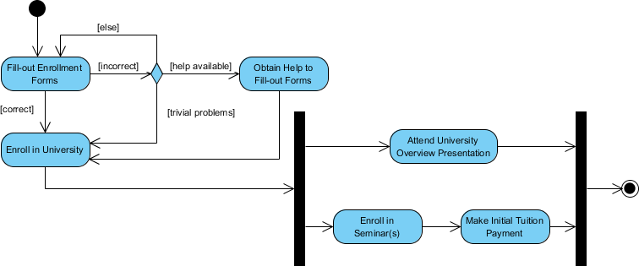
Activity Diagram Example - Student Enrollment
…
18-<number>

Slide 13
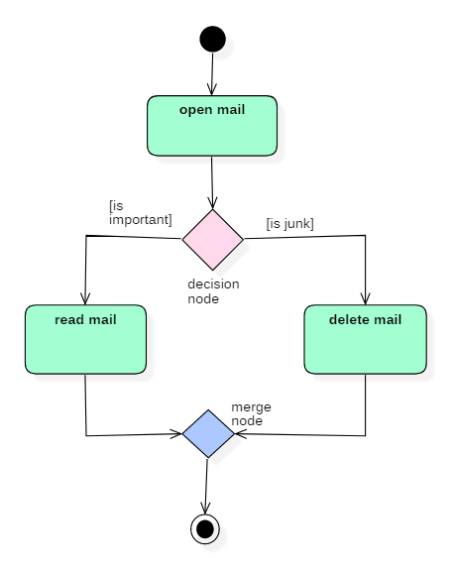
Following diagram represents activity for processing e-mails.
…
18-<number>

Slide 14
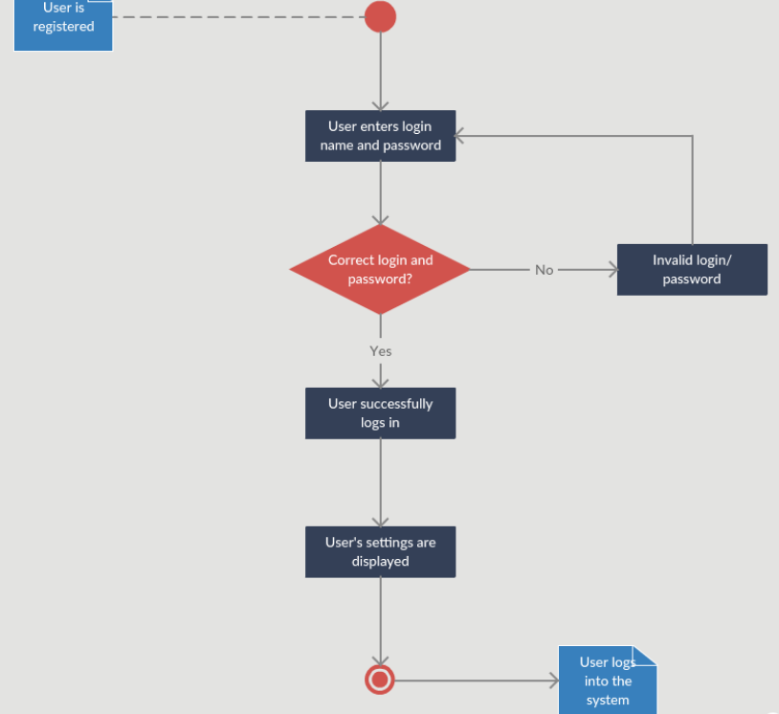
Activity Diagram for Login
…
18-<number>

Slide 15
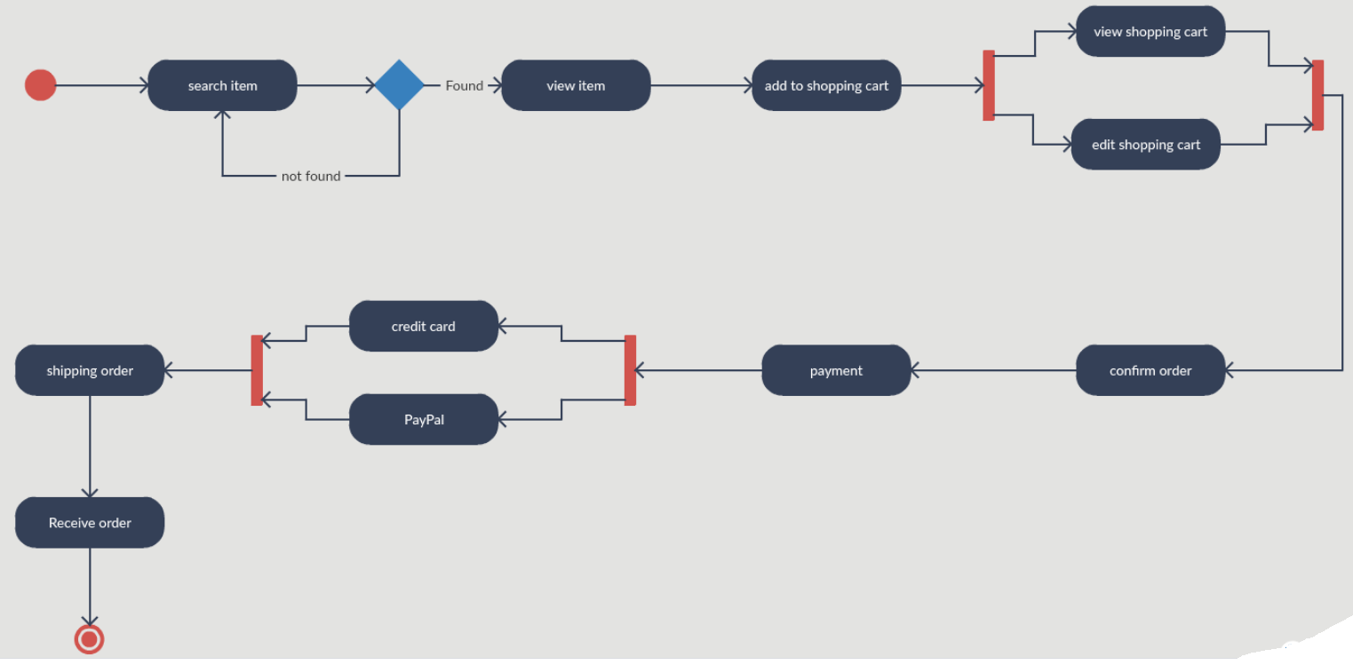
Activity Diagram for Online Shopping System
…
18-<number>

Slide 16
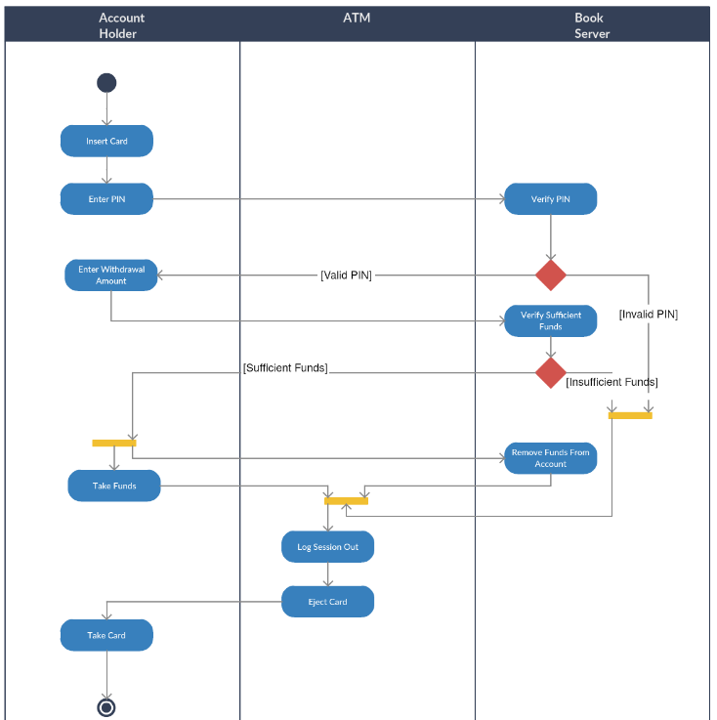
Activity Diagram for ATM
…
18-<number>

Slide 17
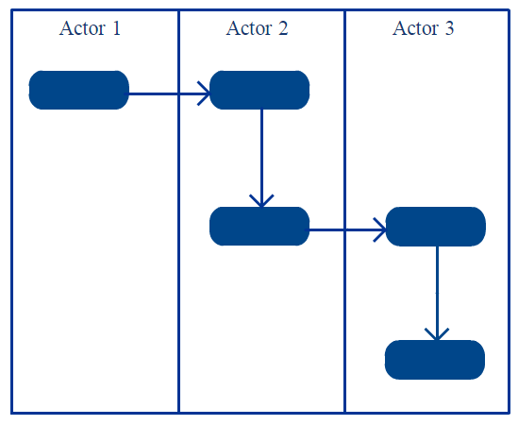
Activity Diagram – Swimlane
In activity diagrams Swimlanes – also known as partitions – are used to represent or group actions carried out by different actors in a single thread.
Here are a few tips you can follow when using Swimlanes.
Add Swimlanes to linear processes. Swimlanes make the process easy to read.
Don’t add more than 5 Swimlanes.
Arrange Swimlanes in a logical manner.
18-<number>

Slide 18
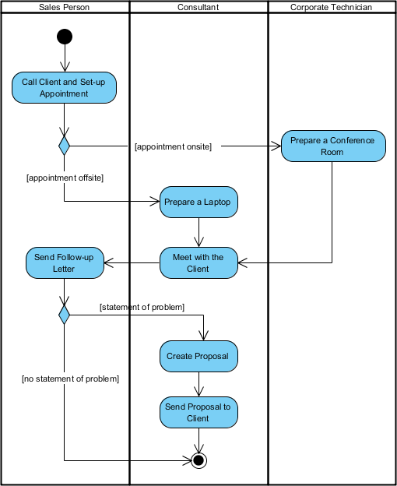
This figure below describes the business process for meeting a new client using an activity Diagram with Swinlanes.
,,,
18-<number>

Slide 19
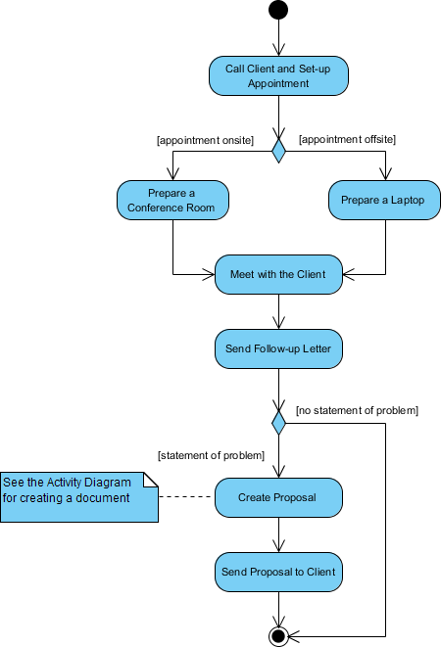
The activity diagram example below describes the business process for meeting a new client using an activity Diagram without swinlane.
,,,
18-<number>

Slide 20
Summary
Activity diagram is also called as object-oriented flowcharts.
Activity diagrams consist of activities that are made up of smaller actions.
Activity is a behavior that is divided into one or more actions.
It uses action nodes, control nodes and object nodes.
An activity partition or a swimlane is a high-level grouping of a set of related actions.
Fork and merge/join nodes are used to generate concurrent flows within an activity.
Activity diagram is used to model business processes and workflows.
18-<number>

